Slide 1
Weather & Flights Performance -
Final Report
DATASCI 261: Machine Learning at Scale
Ahsin Saleem, Anshul Zutshi, Cat Weiss, Jasmol Dhesi, Umesh Kant

Slide 2

Agenda
1
Introduction
2
Project description
3
EDA
4
Modeling Pipelines
5
Results and Discussion of Results
6
Conclusion
7
Credit Assignment Plan

Slide 3





Introduction - Team
Ahsin Saleem
Anshul Zutshi
Cat Weiss
Jasmol Dhesi
Umesh Kant
Notes:
Suhas

Slide 4
Agenda
1
Introduction
2
Project description
3
EDA
4
Modeling Pipelines
5
Results and Discussion of Results
6
Conclusion
7
Credit Assignment Plan

Slide 5

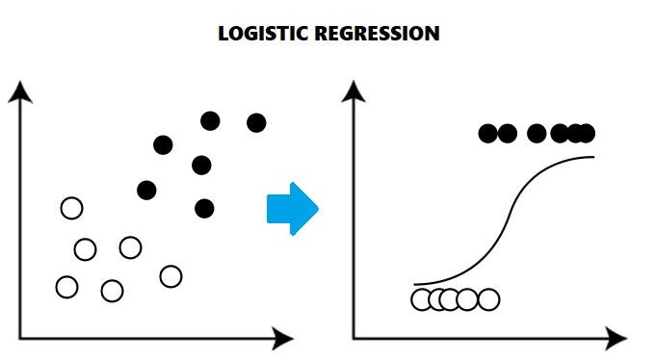
Abstract and Project description
Business Case
We are building a predictive model to determine whether a flight will be delayed or on-time based on historical data, flight information, and weather data.
Predict whether a flight will be delayed by 15 minutes or more to empower passengers in planning their travel.
Baseline Model
True baseline: random selection
Logistic Regression
Complex Models
Random Forests
MLP w/ 1 or 2 hidden layers
Notes:
Anshul
Business Case
We are attempting to predict whether a flight will be delayed or not based on historical data, flight information, and weather data
Baseline Model
For our baseline classification model, we utilized a logistic regression model to classify flights between on-time (arriving before or at scheduled arrival time) and delayed (arriving after scheduled arrival time)
Complex Models

Slide 6
Agenda
1
Introduction
2
Project description
3
EDA
4
Modeling Pipelines
5
Results and Discussion of Results
6
Conclusion
7
Credit Assignment Plan

Slide 7
EDA - High Level Dataset Summary
Flights Data: A subset of passenger flights on-time performance data taken from US department of Transportation
31,746,841 rows, 109 attributes [2015 - 2019]
Weather Data: Weather conditions at flight origin and destination
630,904,436 rows, 177 attributes [ 2015 - 2019]
Airports Metadata: Metadata about each airport from US department of Transportation
18,097 rows, 10 attributes
OTPW (on time performance of flights and weather dataset joined) [60 months]
31,673,119 rows, 214 attributes
Other Reference Data: IATA and ICAO airport code conversion dataset available at https://datahub.io/core/airport-codes
Notes:
Umesh

Slide 8
EDA - OTPW 60 Months
Dataset contains time-period, airline, origin, destination, departure performance, arrival performance, cancellation and diversions, flight summary, and causes of delay etc. information at a high level (31,673,119 rows, and 214 attributes)
Cancellations:
1.5% of flights were cancelled
Cancelled Flights can have Departure Delay BUT no Arrival Delay
Diversions:
0.2% of the flights were diverted
Diverted flights will have null delay when these flights arrived at a destination airport which had a distance greater than Zero as compared to the original destination airport
Causes of Delay:
Causes of Delay like CARRIER_DELAY, WEATHER_DELAY, NAS_DELAY, SECURITY_DELAY, and LATE_AIRCRAFT_DELAY have 16.17% of missing data. Further analysis of these show that this information is populated only for flights which are not cancelled and have arrival time delay of 15 minutes or more.
Notes:
Umesh

Slide 9
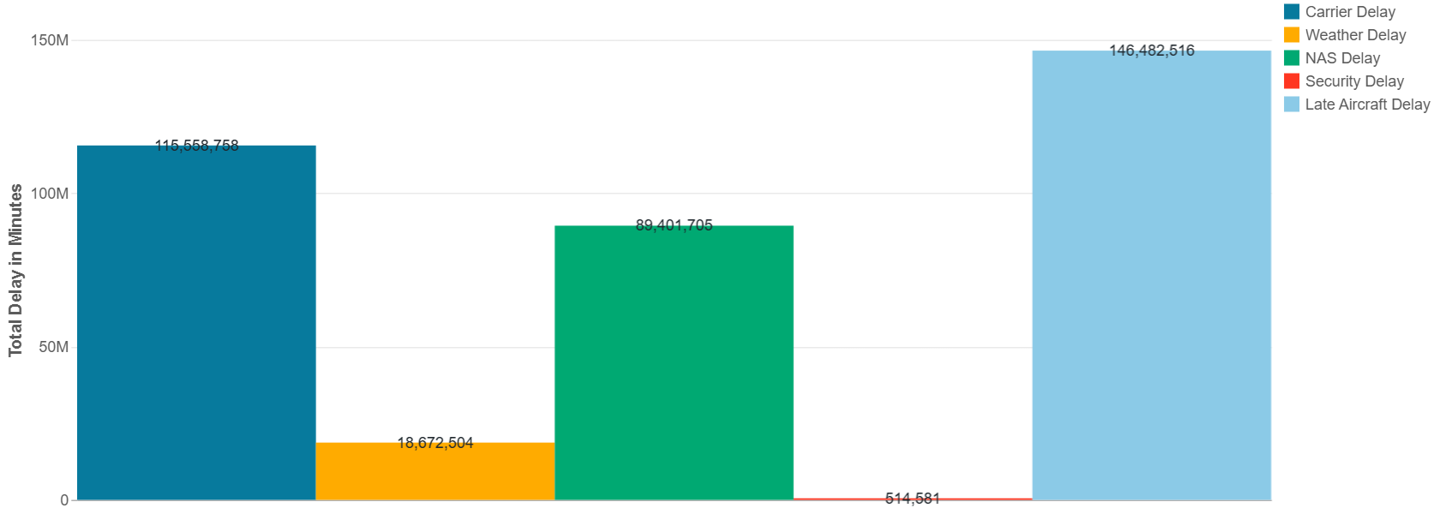
EDA - OTPW 60 Months
Key Causes of Flight Delays
Following are the key causes for flight delays:
Carrier Delay
Weather Delay
National Air System Delay
Security Delay
Late Aircraft Delay
Late aircraft delay is the top cause for arrival delay in minutes overall and security delay is the bottom cause for arrival delay in minutes overall.
Notes:
Umesh

Slide 10
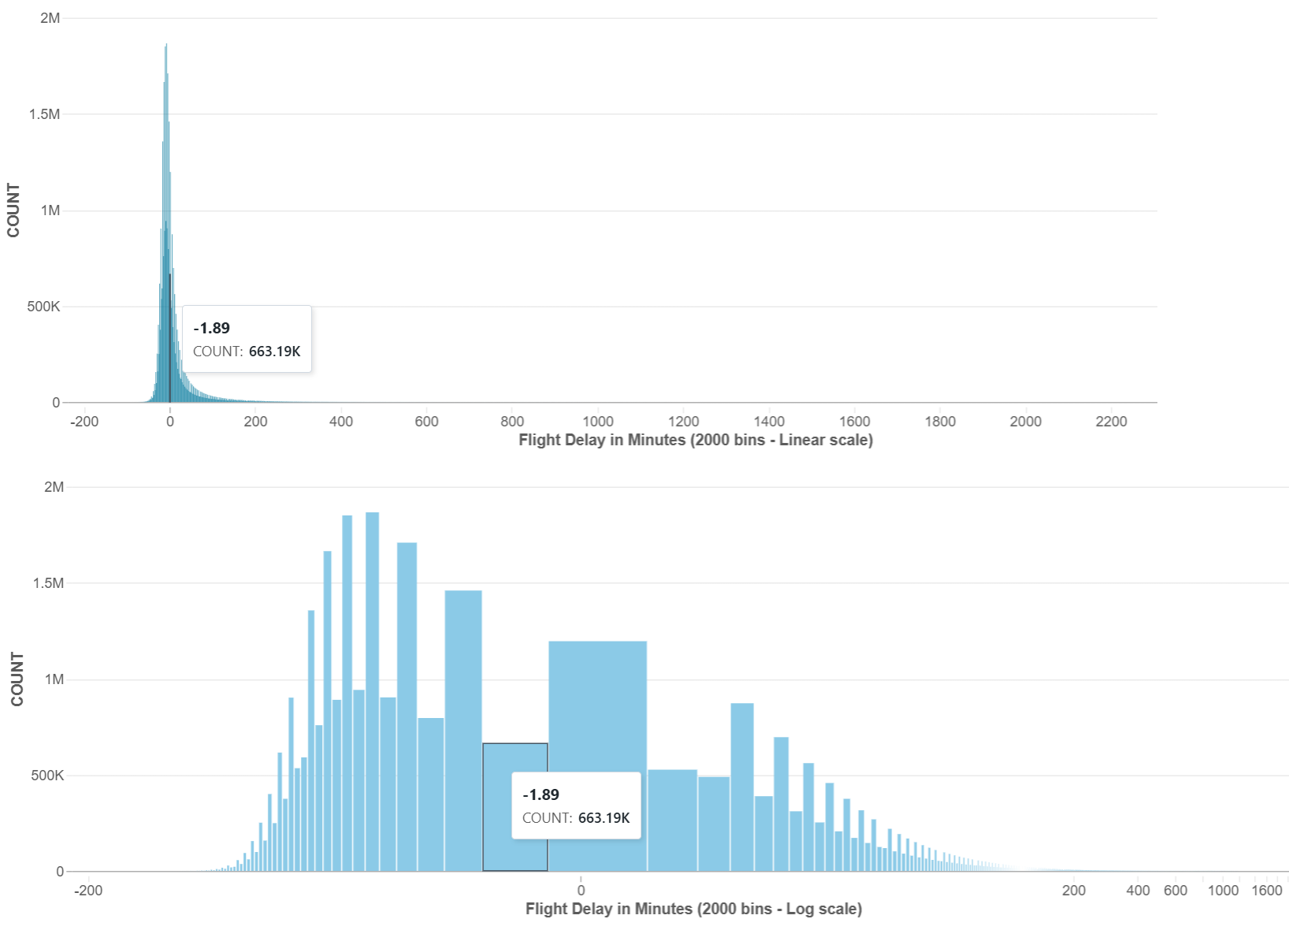
EDA - Flight Performance - OTPW 60 Months
~65% of the flights arrive on or before time
Flights arrival delay has a mean of 4.61 minutes and median of -6 minutes, and max value of 2,695 minutes.
Notes:
Umesh

Slide 11
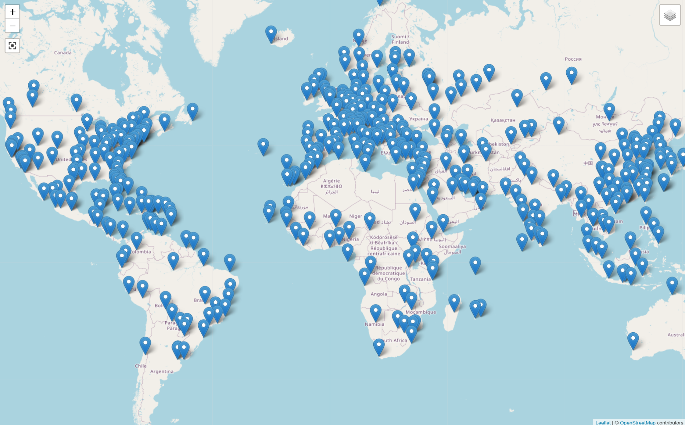
EDA - Airport Codes
Has airport information on Region (Continent, Country, Municipality), airport codes, and Geographical information (Elevation, Latitude, Longitude)
Total distinct rows in the dataset: 82,797
Total Distinct Countries: 246
Total Distinct Regions in US: 51
Map View - Large Airports
Airport Type | Count
large_airport | 482
medium_airport | 4,684
small_airport | 42,109
closed | 12,472
seaplane_base | 1,221
heliport | 21,772
balloonport | 57
Notes:
Umesh

Slide 12
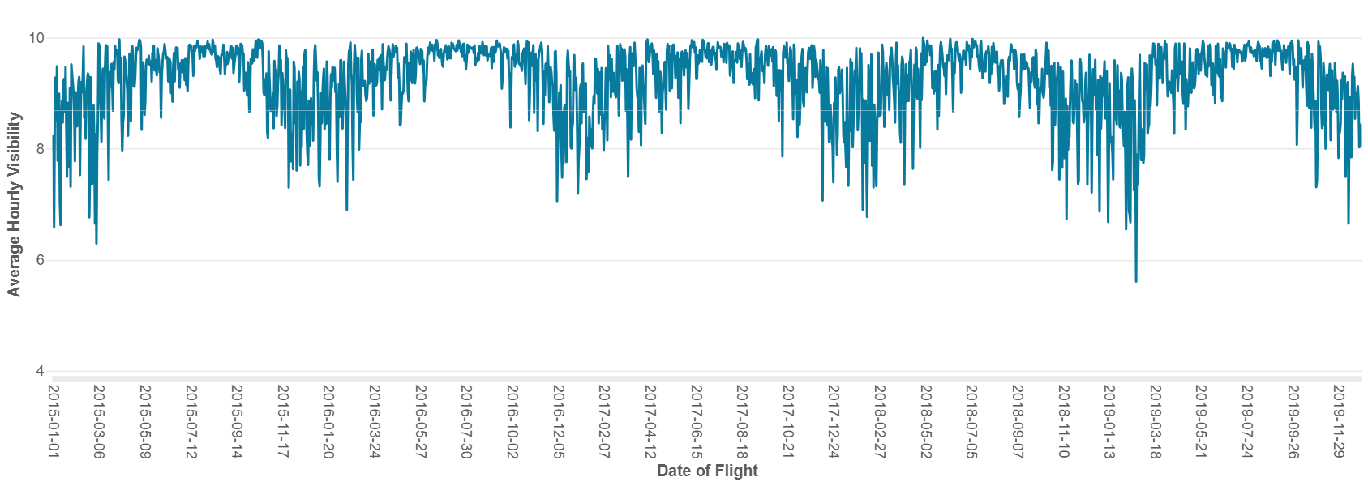
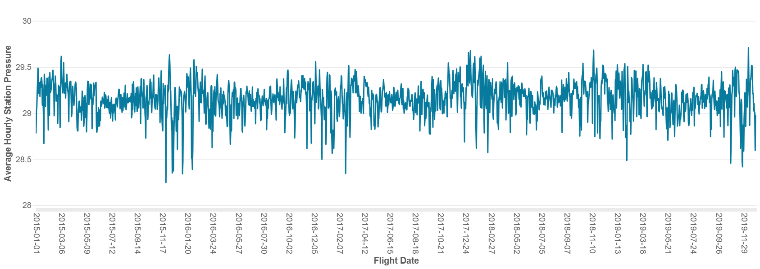
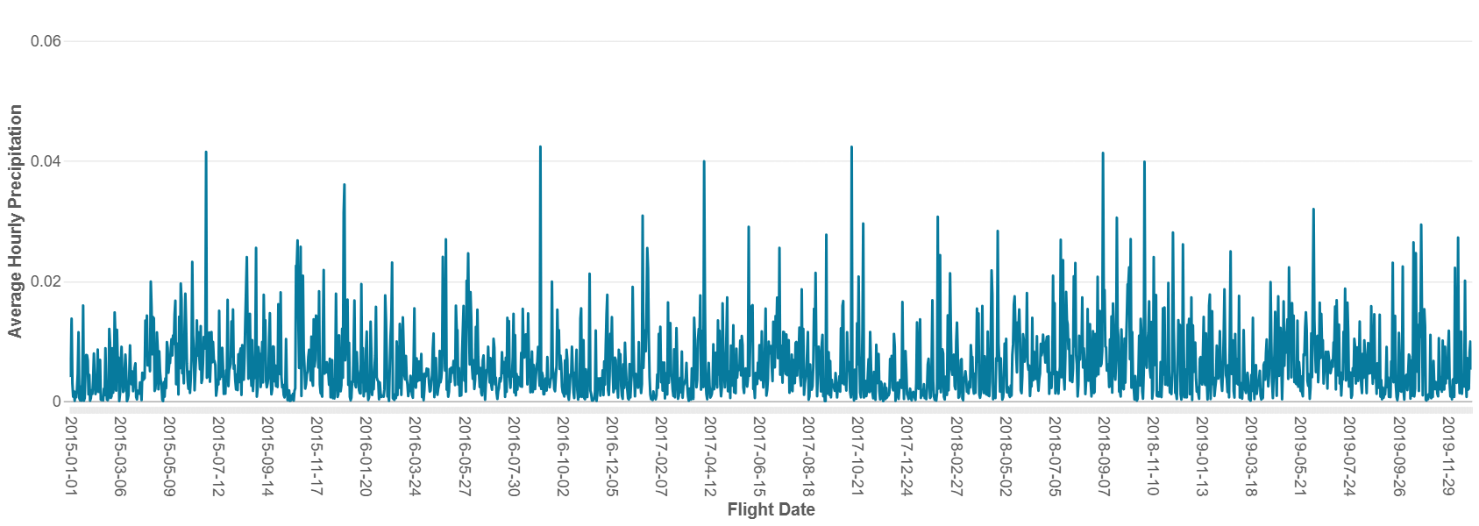
EDA - Weather - OTPW 60 Months
Focussing on all the flights that had weather related delays, looking into each weather condition individually does not offer much clue due to wide range of values for each weather condition.
The models will learn the combination of these weather conditions & other features that lead to flight delays and the magnitude during training
Notes:
Anshul

Slide 13
Target Variable
Derived Features
Federal Aviation Administration Definition of Delay:
More than 15 minutes
Included diverted and cancelled
IS_HOLIDAY
rolling_3month_delay_count
HAS_WEATHER_TYPE
Notes:
Our target variable is a boolean DELAY_TARGET, which is based on the FAA definition of a flight delay of any arrival that's more than 15 minutes late. We included diversions and cancellations in this definition.
"We also derived 3 features:
"IS_HOLIDAY is a binary flag for flights within 3 days of a U.S. holiday.- we expanded this from phase 2 to include the plus or minus three days.
"rolling_3mo_delay_count is our time based feature, grouped by airline, that counts how many delays the airline has had in the last 3 months."
"HAS_WEATHER_TYPE flags any flights affected by visibility-obstructing weather."

Slide 14
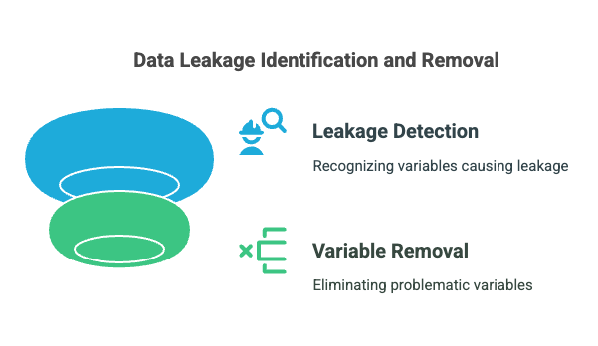
Leakage from Phase 2
DEP_TIME
DEP_DELAY
AIR_TIME
Notes:
After our phase 2 presentation, we investigated leakage in our data
We decided to remove the three variables DEP_TIME, DEP_DELAY, and AIR_TIME as these variables are not available until after the plane takes off. For our use case, it doesnt make sense to predict a delay after the flight takes off.

Slide 15
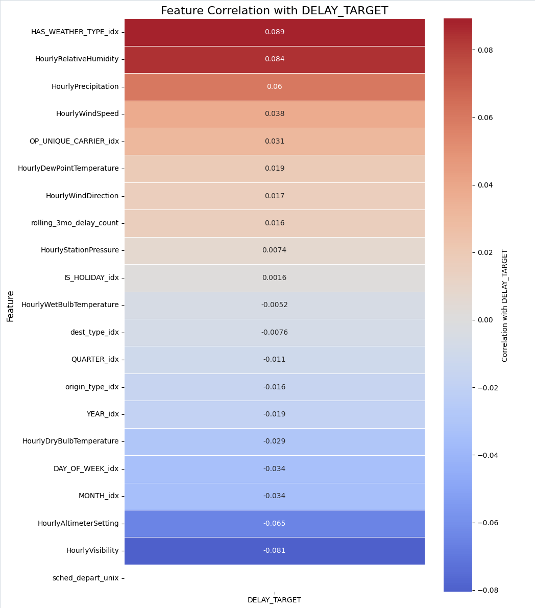
Feature Selection- Correlation
Notes:
"We calculated the correlation between each feature and our target, DELAY_TARGET."
the most positively correlated features are
HAS_WEATHER_TYPE: 0.089 – Suggests flights affected by visibility-reducing weather have a slightly higher likelihood of delay.
HourlyRelativeHumidity: 0.084 – High humidity may be associated with poor weather or reduced visibility.
On the other hand, the most negatively correlated features are:
HourlyVisibility: -0.081 – Lower visibility corresponds with higher delay rates.
HourlyAltimeterSetting: -0.065
all of these top correlating features are weather-related, which aligns with expectations.

Slide 16
Absolute Baseline
Prediction Logic:
Predict 0 ("on time") with probability = proportion of on-time flights in data.
Predict 1 ("delayed") otherwise.
No model training purely based on class distribution
Results:
Precision = 0.2
Recall = 0.2
AUC = 0.5
F1 Score = 0.5

Slide 17
Down Sampling
Keep all delayed flights (minority class = 1)
Randomly sample on-time flights (majority class = 0) to match minority count
Union both to create a balanced dataset
Keep temporal order

Slide 18
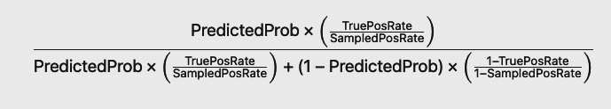
Calibration Method
Updating the posterior probability (true probability of being positive) based on:
The predicted probability from the model (i.e., likelihood estimate from rebalanced data)
The true prior class probabilities from the original data (i.e., before downsampling)
Bayes’ Rule is applied to adjust for the mismatch in priors

Slide 19
Agenda
1
Introduction
2
Project description
3
EDA
4
Modeling Pipelines
5
Results and Discussion of Results
6
Conclusion
7
Credit Assignment Plan

Slide 20
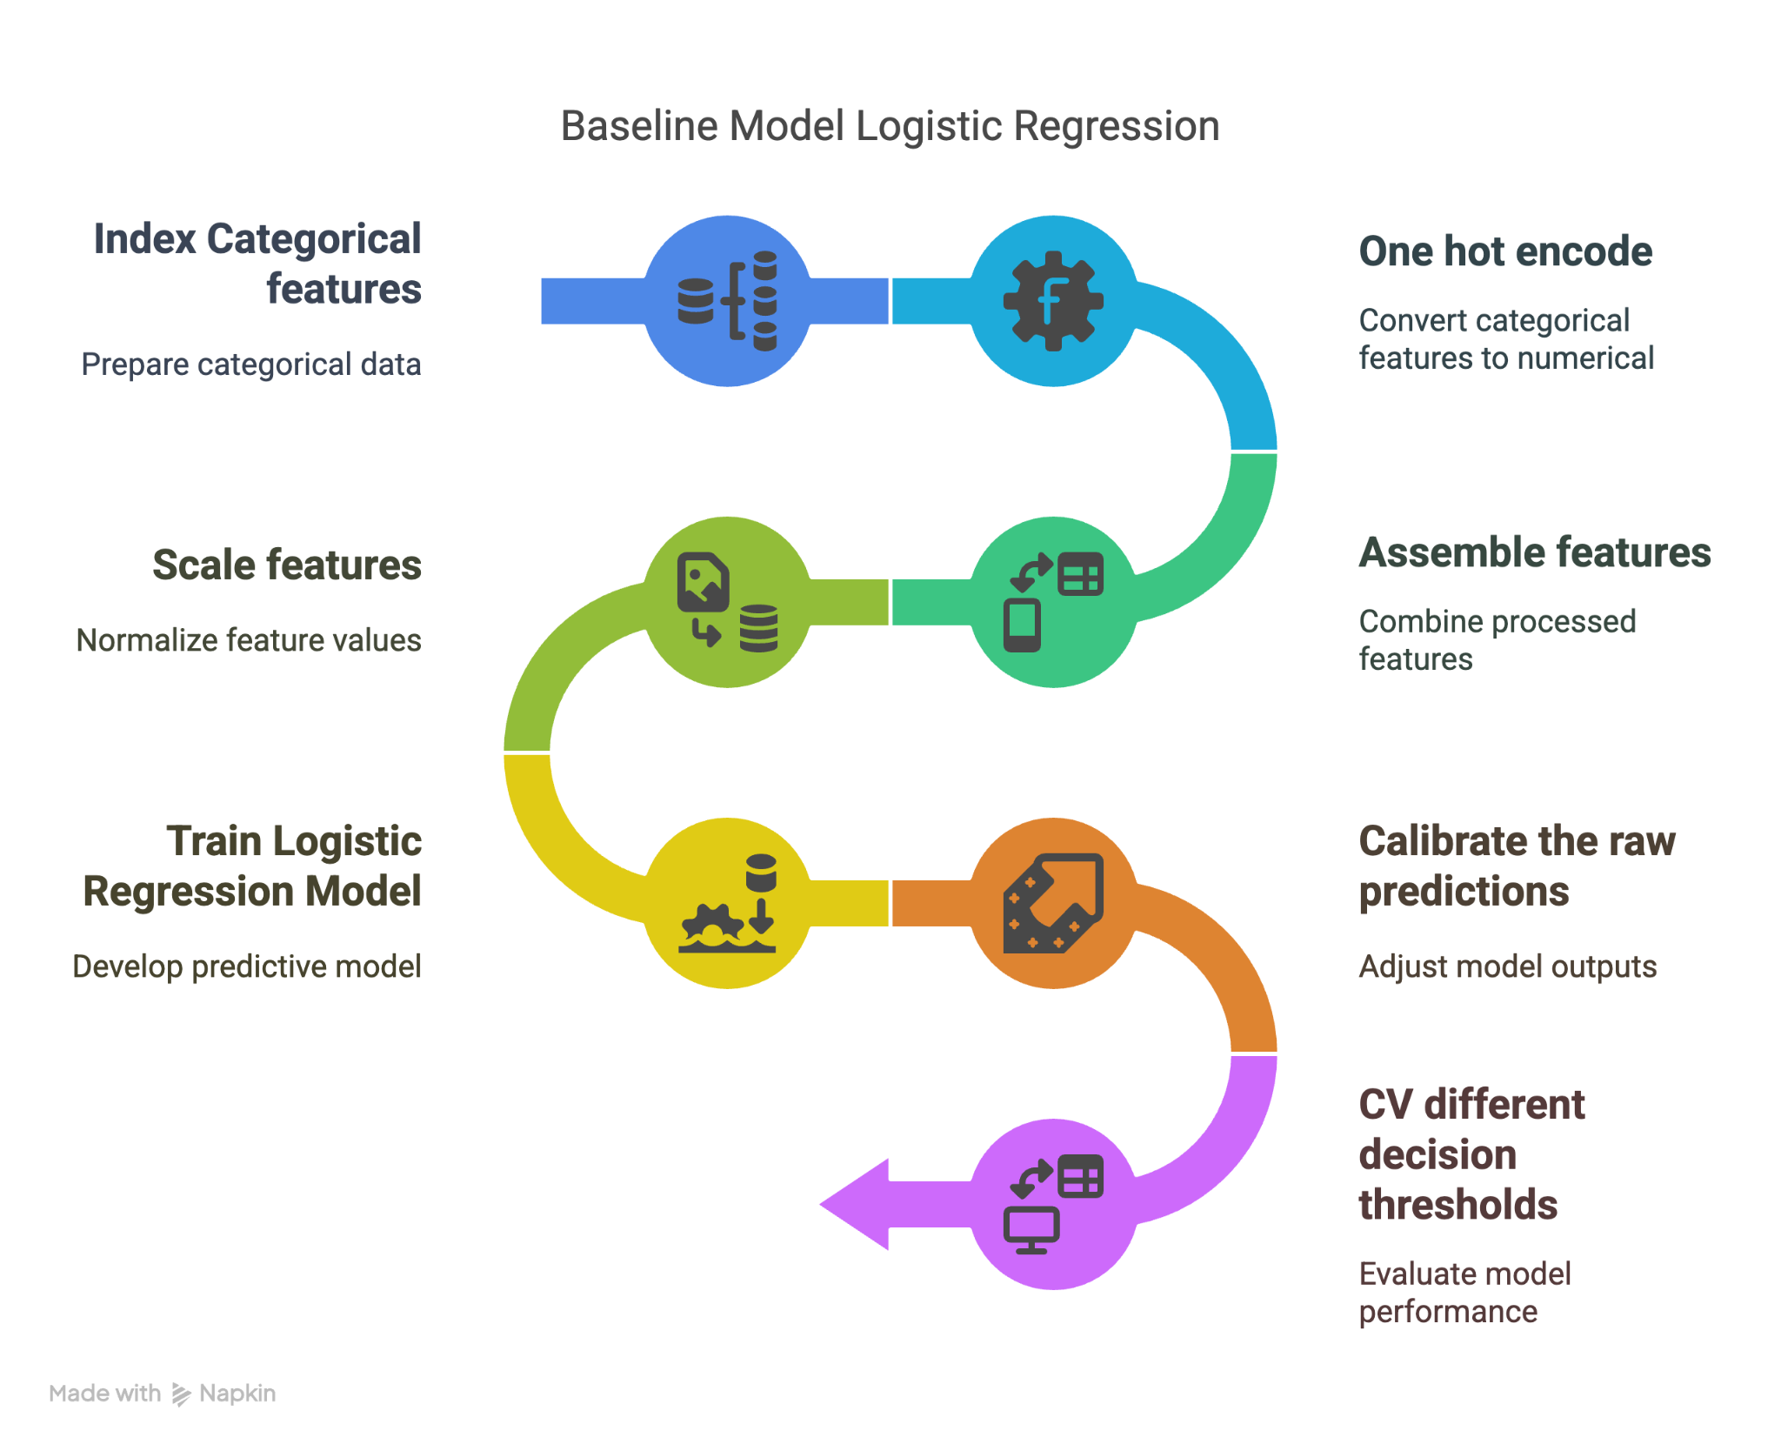
Baseline Model Pipeline:

Slide 21
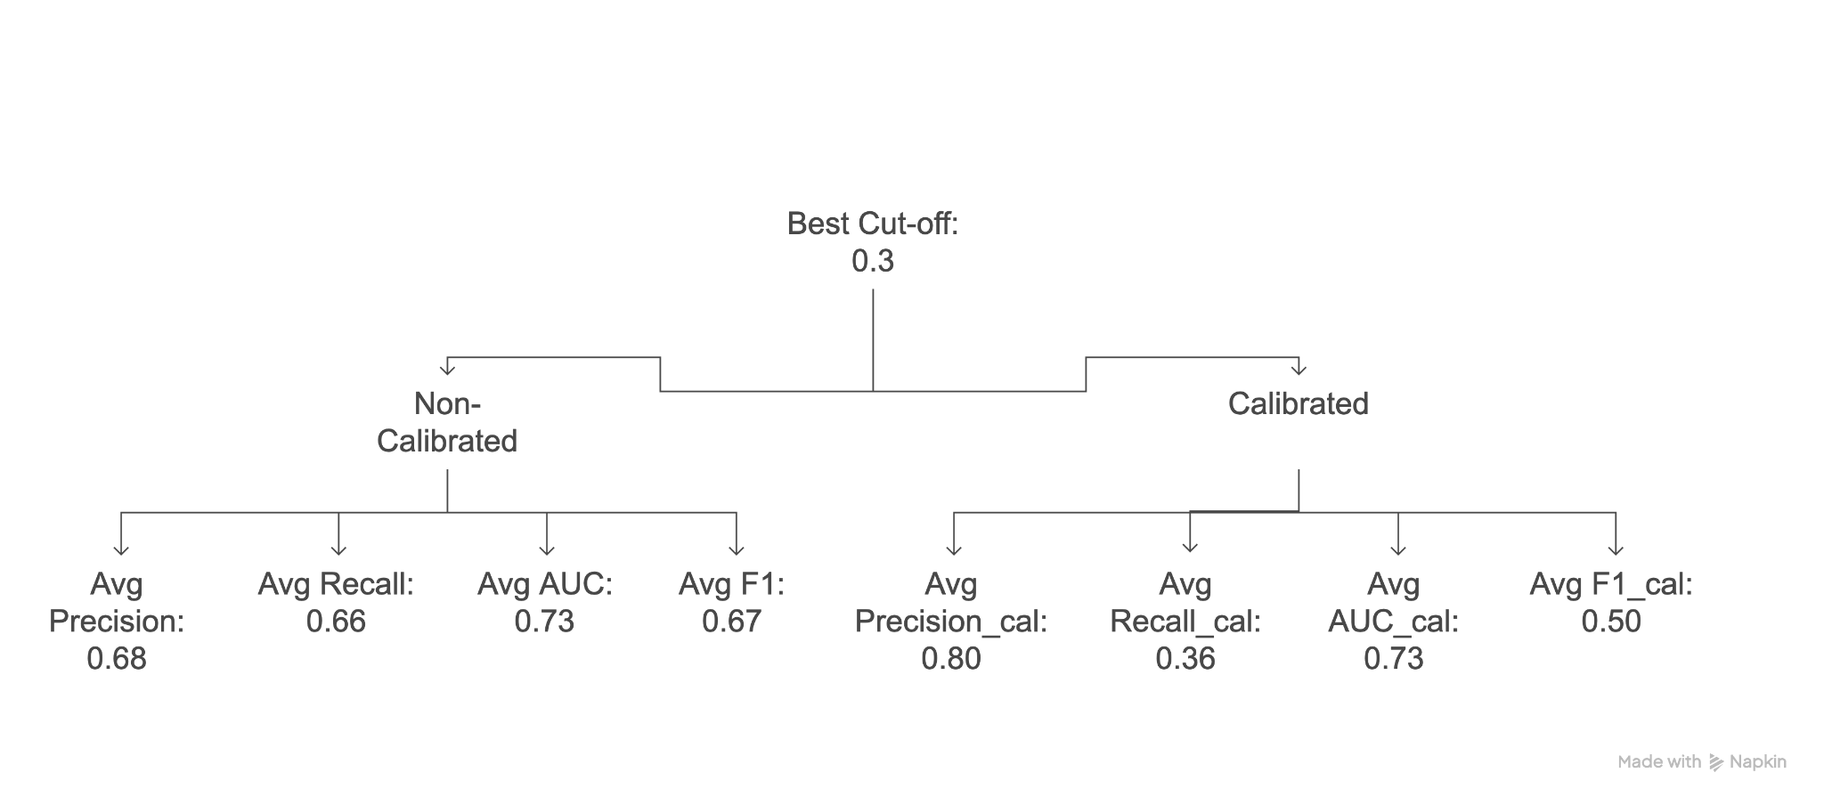
Baseline CV Results:

Slide 22
Advance Model Pipeline
Carrying over the pre-existing pipeline, we now incorporate a grid-search for hyperparameter tuning and classification models aimed at achieving improved performance:
Models Evaluated:
Multilayer Perceptron (MLP) neural networks
Single and Double Hidden Layers
Random Forest
Developed new pipeline which omitted the one-hot encoding
We prioritize maximizing Recall to reduce the risk of misclassifying on-time flights as delayed. This approach is designed to prevent unnecessary disruptions and ensure that departures remain on schedule.

Slide 23
Baseline vs Advanced Model Pipeline
1
Index Categorical Features
2
One Hot Encode (not for Random Forest)
3
Scale and Assemble Features
4
Train Models
5
Tune Parameters with Grid-Search and CV
6
Fit Models to Test Dataset and Evaluate
7
Calibrate Model Performance
Baseline Model
Advanced Model Pipeline

Slide 24
Agenda
1
Introduction
2
Project description
3
EDA
4
Modeling Pipelines
5
Results and Discussion of Results
6
Conclusion
7
Credit Assignment Plan

Slide 25
Calibrated Cross-Validation Results (Sorted by Recall)
Model | Precision | Recall | AUC | F1
Absolute Baseline | 0.2000 | 0.2000 | 0.5000 | 0.2000
MLP Single-Layer | 0.9368 | 0.7069 | 0.8866 | 0.8052
MLP Dual-Layer | 0.8216 | 0.6875 | 0.8650 | 0.7848
Logistic Regression (Baseline) | 0.6772 | 0.6640 | 0.7338 | 0.4980
Random Forest | 0.8635 | 0.3979 | 0.7884 | 0.5441
Table 1. Time-Series Cross-Validation Results for Training Dataset

Slide 26
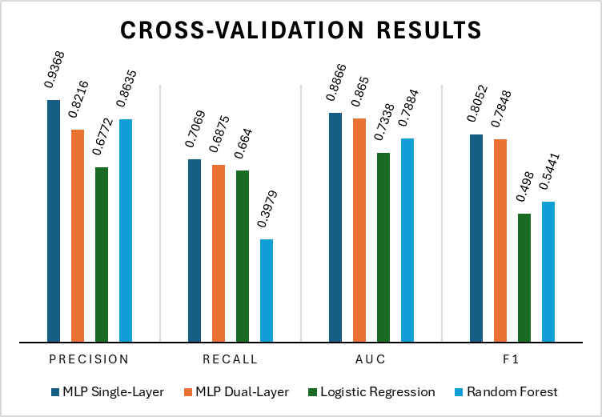
Cross-Validation Results (cont.)
Figure 1. Cross-Validation Results by Metric

Slide 27
Model Evaluation Results (Sorted by Recall)
Model | Precision | Recall | AUC | F1 | Note
Absolute Baseline | 0.2000 | 0.2000 | 0.5000 | 0.2000
MLP Single-Layer | 0.8232 | 0.6961 | 0.8992 | 0.7544 | layers=[32, 10, 2], maxIter=100, stepSize=0.01
MLP Dual-Layer | 0.7408 | 0.6276 | 0.8633 | 0.6795 | layers=[32, 30, 15, 2], maxIter=100, stepSize=0.01
Logistic Regression (Baseline) | 0.4351 | 0.3963 | 0.7172 | 0.4148
Random Forest | 0.5238 | 0.1289 | 0.6875 | 0.2069 | best_numTrees: 20 best_maxDepth: 12
Table 2. Model Evaluation Results on Test Dataset

Slide 28
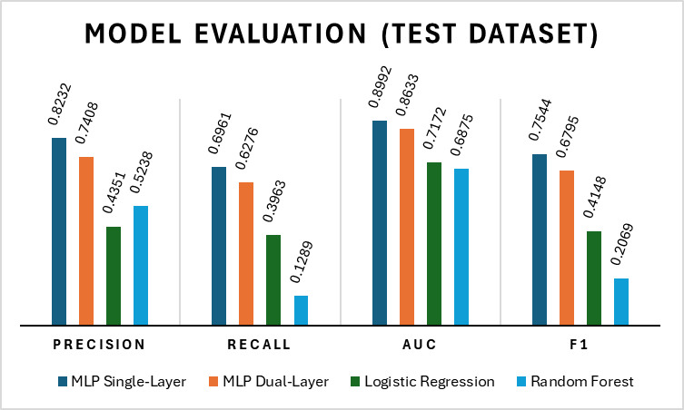
Model Evaluation (cont.)
Figure 2. Model Evaluation Results

Slide 29
Results Discussion
The Single Layer MLP achieved the highest overall performance
The MLP Dual-Layer model also performs well but is slightly less effective than the single-layer model.
Both Logistic Regression and Random Forest models lag significantly behind.
The Random Forest model delivered the lowest scores among the alternative models, only slightly surpassing the Logistic Regression model on Precision.

Slide 30
Agenda
1
Introduction
2
Project description
3
EDA
4
Modeling Pipelines
5
Results and Discussion of Results
6
Conclusion
7
Credit Assignment Plan

Slide 31
Conclusion
Extracted and ranked feature importance scores using contextual knowledge and correlation matrices to determine the most influential predictors for delay predictions.
Constructed a pipeline incorporating essential preprocessing steps including indexing, vector assembling, and scaling.
Employed grid search to identify optimal hyperparameters.
Developed a calibration process to balance model evaluation scores to prevent bias from down-sampling.
The calibrated Single-Layer MLP model achieved balanced performance across all evaluated metrics, demonstrating robustness in predicting delays.

Slide 32
Final Model
Single Layer Multilayer Perceptron (MLP)
# of Features:
32 Features (MinMaxScaled)
Top 10 Best Features (LR)
DAY_OF_MONTH, ELEVATION, sched_depart_unix, HourlyWindDirection, rolling_3mo_delay_count, HourlyDryBulbTemperature, OP_UNIQUE_CARRIER = F9, OP_UNIQUE_CARRIER = G4, OP_UNIQUE_CARRIER = B6, OP_UNIQUE_CARRIER = VX
HyperParameters
layers=[32, 30, 15, 2], maxIter=100, stepSize=0.01
Performance Metrics:
Precision=0.8232
Recall=0.6961
AUC=0.8992
F1=0.7544

Slide 33
Next Steps (Prior to Report Submission)
Decision Trees: Implement decision trees for their interpretability, inherent feature selection, and their effectiveness in capturing non-linear relationships.
Ensemble Approaches: Integrating advanced models through ensemble techniques like boosting or stacking to further improve predictive performance.
Hyperparameter Tuning: Continue to experiment with hyperparameter tuning (e.g., depth for trees, number of neurons and layers for MLP) to identify the optimal balance between model complexity and generalization.
Notes:
Advanced Feature Engineering: Identify most relevant features using techniques such as PCA to capture essential variance for Random Forest Optimization.

Slide 34
Agenda
1
Introduction
2
Project description
3
EDA
4
Modeling Pipelines
5
Results and Discussion of Results
6
Conclusion
7
Credit Assignment Plan

Slide 35
Credit Assignment Plan
Phase | Leaders
Phase One | Cat Weiss
Phase Two | Umesh Kant, Jasmol Dhesi
Phase Three | Ahsin Saleem, Anshul Zutshi
Task | Responsible Party
EDA | Anshul, Umesh
Feature Engineering | Cat, Anshul
ML baseline pipeline | Ahsin
Experimenting with features & Improvements | Jasmol, Umesh, Anshul
Data Join | Umesh, Ahsin
Notes:
Umesh

Slide 36
Thank You!

Slide 37
Questions?

Slide 38
Feedback
Maybe rolling_3mo_delay_count is an important feature
Check if the MLP Single Layer scores are correct

